Slide 1
moose for dcs world setup guides

Slide 2
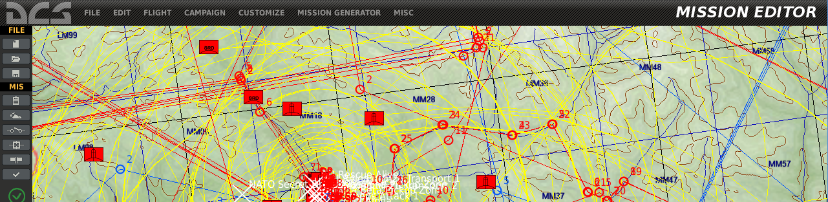
videos explaining how to setup your environment

Slide 3
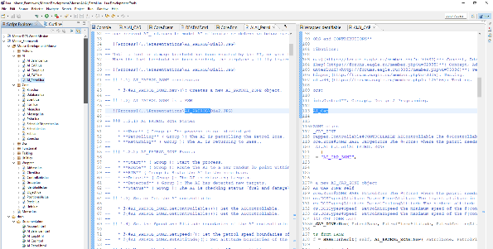
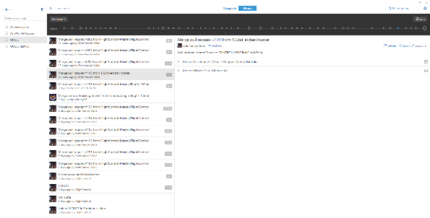
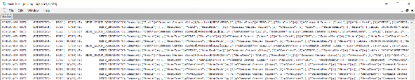
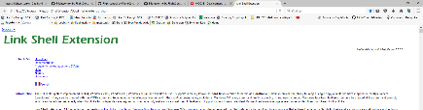

various tools augment the mission design experience
MISSION EDITOR
ECLIPSE ENVIRONMENT
GIT HUB DESKTOP
TOOLS
LOGGING TRAILING
UTILITIES …

Slide 4
ldt setup

Slide 5
moose for dcs world LUA DEV TOOLS (LDT) SETUP

Slide 6
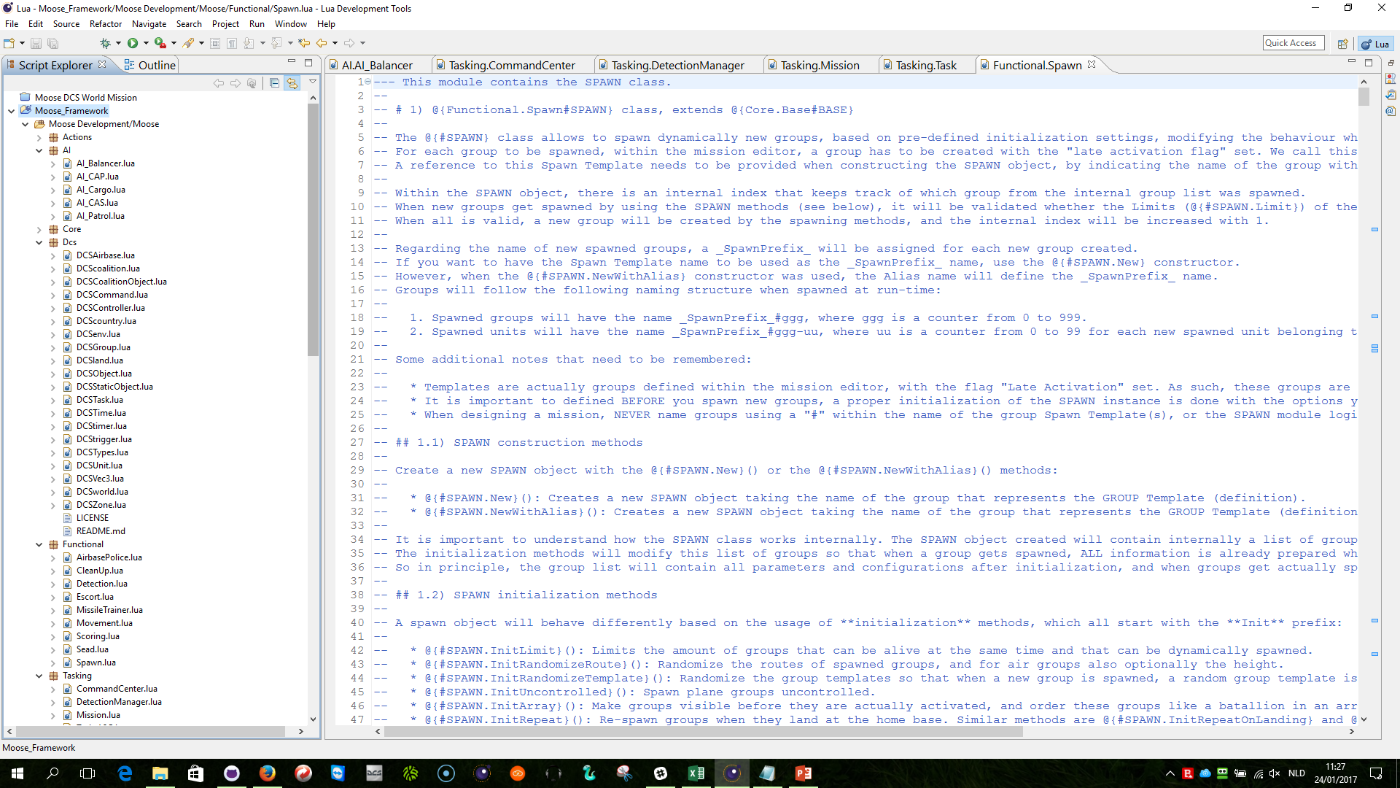
ldt setup
LDT: https://eclipse.org/ldt/
JAVA: https://java.com/en/download/

Slide 7
moose for dcs world GITHUB desktop setup

Slide 8
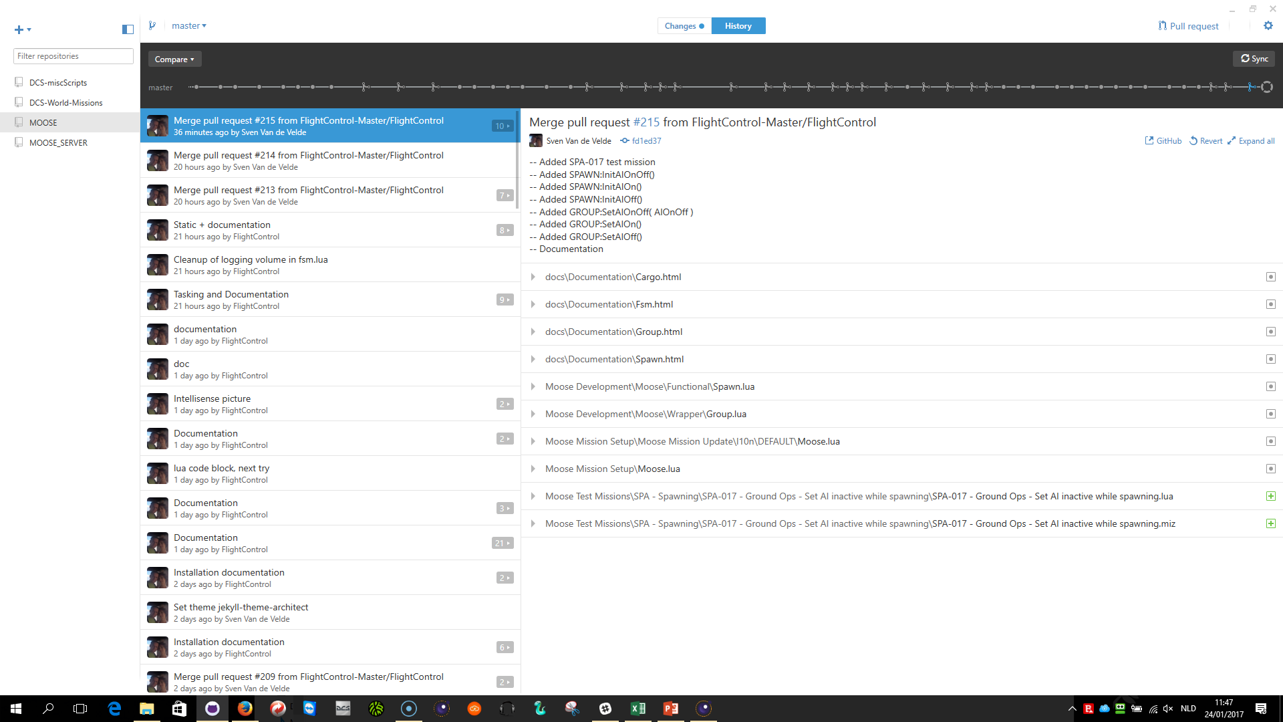
GITHUB DESKTOP SET
GITHUB DESKTOP: https://desktop.github.com/
MOOSE: https://github.com/FlightControl-Master/MOOSE

Slide 9
moose for dcs world CONFIGURE MOOSE in LDT

Slide 10
moose for dcs world Synchronize the DCS submodule from github

